Slide 1
AVL Trees
Data Structures & Program Design in C 2nd Ed
Robert Kruse / C.L. Tondo / Bruce Leung

Slide 2
AVL Trees
Named after 2 Russian Mathematicians
G.M. Adel'son-Vel'skii and E.M. Landis
Definition
An AVL Tree is a Binary Search Tree in which the heights of the left and right subtrees of the root differ by at most 1 and in which the left and the right subtrees are again AVL trees.

Slide 3
Note:
With each node of an AVL tree is associated a Balance Factor that is Left Higher, Equal Height or Right High according, respectively, as the left subtree has height greater than, equal to, or less than that of the right subtree.
In tree diagrams, / represents left high
- represents equal height
\ represents right high

Slide 4
Examples:
AVL Trees

Slide 5
Non-AVL Trees

Slide 6
Note:
All the leaves are not required to be on the same or adjacent levels.
AVL Trees can be quite skewed. The following are examples of AVLTrees skewed to the right:

Slide 7
Simple Insertions of Nodes into an AVL Tree:
k
k
k
k
t
e
t
e
t
v
k
k
k
e
t
e
t
e
t
p
v
a
p
v
a
p
v
Insert u and h
n

Slide 8
Rotations
New node is inserted into the taller subtree of the root and its height has increased so that one subtree has height 2 more than the other e.g.,
Node 6 is added:
2
4
must become
5
1
4
2
3
5
1
3
6
6

Slide 9
Node 5 is added:
2
4
must become
6
1
6
2
4
7
1
5
7
5
There are 3 cases to consider in order to restore the balance in an AVL tree

Slide 10
Case 1 – Right Balance - Right High
The root is doubly right high and the root of the right subtree is also right high => left rotation
Right High (tree), subtree (rs) is also Right High => LEFT ROTATION
Node 6 is added:
tree
2
4
rs
LEFT ROTATE
to become
1
4
2
5
3
5
1
3
6
6

Slide 11
So what has happened?
3 becomes the right child of 2
2 becomes the left child of 4
4 becomes the new root of the tree.
tree
2
LEFT ROTATE
to become
4
rs
1
4
2
5
3
5
1
3
6
6

Slide 12
In general
tree's right pointer becomes equal to rs's left pointer
tree
2
4
rs
LEFT ROTATE
to become
1
4
2
5
3
5
1
3
6
6
Note: don't loose the pointer to rs

Slide 13
In general
tree's right pointer becomes equal to rs's left pointer
rs's left pointer becomes equal to tree
tree
2
4
rs
LEFT ROTATE
to become
1
4
2
5
3
5
1
3
6
6

Slide 14
In general
tree's right pointer becomes equal to rs's left pointer
rs's left pointer becomes equal to tree
rs becomes the new root of the tree
tree
tree
2
4
LEFT ROTATE
to become
rs
1
4
2
5
3
5
1
3
6
6
Note: Need the pointer to rs here to make it the root

Slide 15
template <class ItemType>
void RotateLeft (TreeNode<ItemType> * & tree)
{
TreeNode<ItemType> * rs;
if (tree == NULL)
cerr << "It is impossible to rotate an empty tree in RotateLeft"
<< endl;
else if (tree->right == NULL)
cerr << "It is impossible to make an empty subtree the root in
RotateLeft" << endl;
else

Slide 16
{
rs = tree->right;
tree->right = rs->left;
rs->left = tree;
tree = rs;
}
}
tree
2
rs
1
4
3
5
6
don't loose the pointer to
tree's right pointer becomes equal to rs's left pointer
rs's left pointer becomes equal to tree
rs becomes the new root of the tree

Slide 17
In general
tree's right pointer becomes equal to rs's left pointer
rs's left pointer becomes equal to tree
rs becomes the new root of the tree
tree
tree
rs
T₁
T₃
h
T₂
T₃
T₁
T₂
h +1
h
h
h
h +1

Slide 18
Case 2 – Right Balance - Left High
The root is doubly right high and the root of the right subtree is left high => double rotation
Right High (tree), subtree (rs) is Left High => DOUBLE ROTATION
Node 5 is added:
2
4
must become
6
1
6
2
4
7
1
5
7
5

Slide 19
How does this double rotate work?
Right rotate followed by a left rotate.
Rotate the subtree with root rs to the right so that ls becomes its root.
tree
2
2
rs
1
6
1
4
ls
4
7
6
5
5
7

Slide 20
Rotate tree to the left moving this node up again to become the new root.
tree
tree
2
4
1
4
2
6
6
1
5
7
5
7
Note: The Balance Factors…….

Slide 21
template <class ItemType>
void RotateRight (TreeNode<ItemType> * & tree)
{
TreeNode<ItemType> * ls;
if (tree == NULL)
cerr << "It is impossible to rotate an empty tree in RotateRight"
<< endl;
else if (tree->left == NULL)
cerr << "It is impossible to make an empty subtree the root in
RotateRight" << endl;
else

Slide 22
{
ls = tree->left;
tree->left = ls->right;
ls->right = tree;
tree = ls;
}
}
Note:
From a code point of view, remember RotateLeft().
If you require a RotateRight(), change all the lefts to rights and all the rights to lefts!

Slide 23
In general:
overall height h+2
overall height h+3
tree
tree
rs
T₁
h
T₄
T₁
T₂
T₃
T₄
T₂
T₃
h
h-1 or h
h-1 or h
h
h
h-1 or h
h-1 or h

Slide 24
Balance Factors: Identify the three nodes in question as r, x, w
tree
tree
r
w
rs
T₁
x
r
x
h
w
T₄
T₁
T₂
T₃
T₄
T₂
T₃
h
h-1 or h
h-1 or h
h
h
h-1 or h
h-1 or h

Slide 25
Old w - EH New r - EH New x - EH
tree
tree
r
w
rs
T₁
x
r
x
h
w
T₄
T₁
T₂
T₃
T₄
T₂
T₃
h
h
h
h
h
h
h

Slide 26
Old w / LH New r - EH New x \ RH
tree
tree
r
w
rs
T₁
x
r
x
h
w
T₄
T₁
T₂
T₃
T₄
T₂
T₃
h
h
h-1
h-1
h
h
h

Slide 27
Old w \ RH New r / LH New x - EH
tree
tree
r
w
rs
T₁
x
r
x
h
w
T₄
T₁
T₂
T₃
T₄
T₂
T₃
h
h-1
h
h-1
h
h
h

Slide 28
Case 3 – Right Balance - Equal Height
The root is doubly right high and the root of the right subtree is equal height => ERROR, impossible case
Try and force this situation to happen.

Slide 29
template <class ItemType>
void TreeType<ItemType> :: InsertItem( ItemType item)
// Calls recursive function Insert to insert item into tree.
{
bool taller=false;
Insert (root, item, taller);
}

Slide 30
template <class ItemType>
void Insert (TreeNode<ItemType>*& tree, ItemType item, bool & taller)
// Inserts item into tree. // Post: item is in tree; search property is maintained.
{
if (tree == NULL)
{ // Insertion place found.
tree = new TreeNode<ItemType>;
tree->left = NULL;
tree->right = NULL;
tree->info = item;
tree->bf = EH;
taller = true;
}

Slide 31
else if ( item == tree->info)
cerr << "Duplicate key is not allowed in AVL tree." << endl;
else if (item < tree->info)
{ Insert (tree->left, item, taller); // Insert into left subtree if (taller) switch (tree->bf) {
case LH: LeftBalance(tree, taller); break;
case EH: tree->bf = LH; break;
case RH: tree->bf = EH; taller = false; break;
}
}

Slide 32
else {
Insert (tree->right, item, taller); // Insert into right subtree if (taller)
switch (tree->bf)
{
case RH: RightBalance (tree, taller); break;
case EH: tree->bf = RH; break;
case LH: tree->bf = EH; taller = false; break;
}
}
}

Slide 33
template <class ItemType>
void RightBalance (TreeNode<ItemType> *& tree, bool & taller)
{
TreeNode<ItemType> * rs = tree->right;
TreeNode<ItemType> * ls;
switch (rs->bf)
{
case RH: tree->bf = rs->bf = EH;
RotateLeft(tree);
taller = false;
break;

Slide 34
case EH: cerr << "Tree already balanced " << endl;
break;

Slide 35
case LH: ls = rs->left;
switch (ls->bf)
{
case RH: tree->bf = LH;
rs->bf = EH;
break;
case EH: tree->bf = rs->bf = EH;
break;
case LH: tree->bf = EH;
rs->bf = RH;
break;
}

Slide 36
ls->bf = EH;
RotateRight(tree->right);
RotateLeft(tree);
taller = false;
}
}
Note:
See AVL Tree Example

Slide 37
Insert 13
4
2
6
Right Balance, left rotate, since the subtree rooted at 6 is doubly right high and the root of its right subtree is also right high
1
5
10
8
12
4
13
2
10
1
6
12
5
8
13

Slide 38
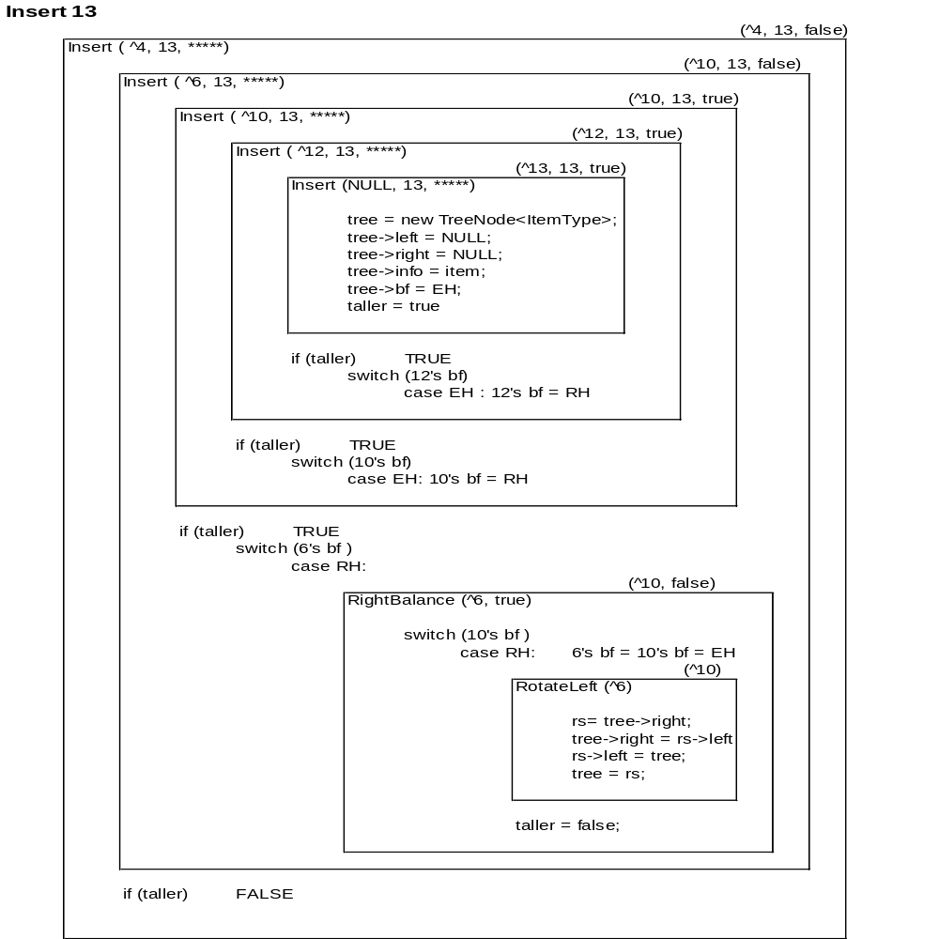

Slide 39
4
Insert 7
2
6
Right Balance, double rotate, since the subtree rooted at 6 is doubly right high and the root of its right subtree is left high
1
5
10
8
12
7
4
4
2
6
2
8
1
5
8
1
6
10
7
10
5
7
12
Right Rotate
Left Rotate
12

Slide 40
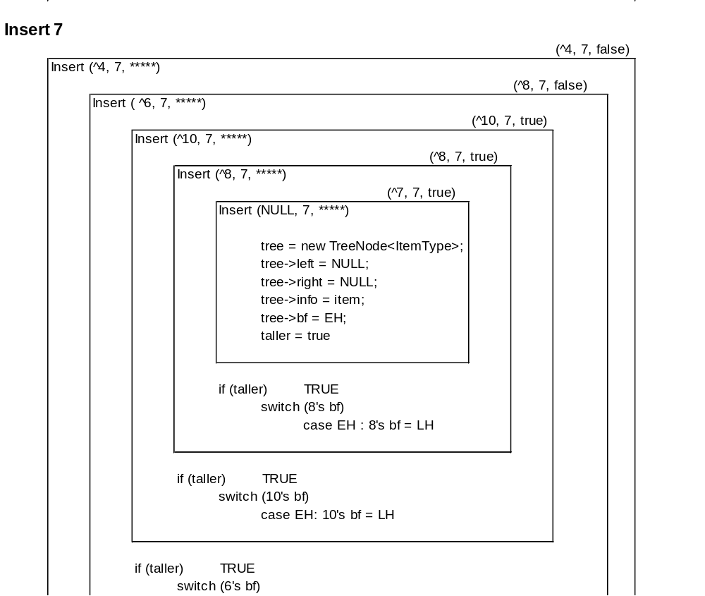

Slide 41
